Slide 1
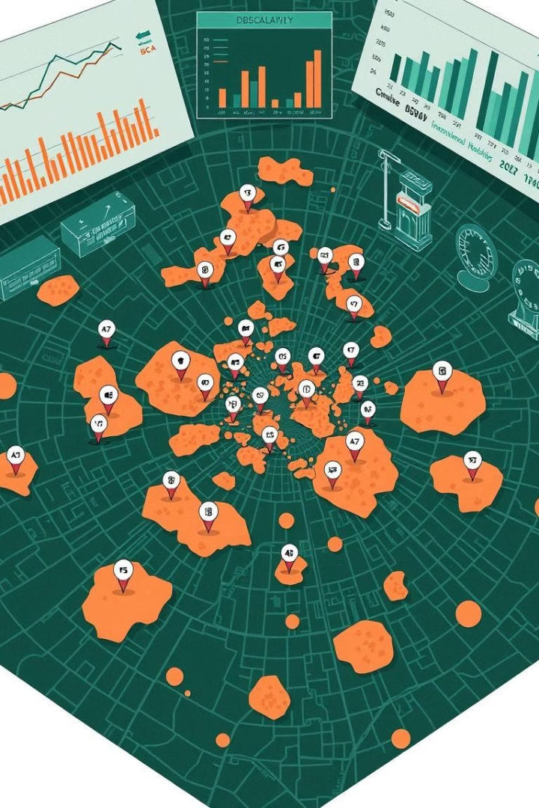

Crime Analysis Using DBSCAN
Course : Data Mining Techniques.
Presented by : Anurag Tiwari & Wagish Vatsa.
Presented to : Prof. Vandana Bhattacharjee.

Slide 2

Introduction & Problem Statement
1
Introduction
2
Problem
Crime analysis is crucial for law enforcement & public safety.
Traditional crime mapping lacks efficiency in detecting patterns.
3
Solution
DBSCAN offers an advanced approach to identify crime hotspots.

Slide 3
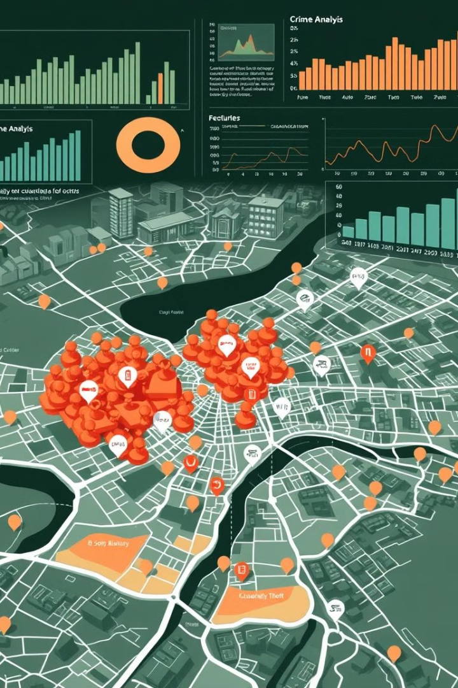
Literature Review & Why DBSCAN?
Crime Data Analysis
Why DBSCAN?
Data mining is widely used for crime pattern detection.
Detects irregularly shaped crime clusters.
Various clustering techniques are applied in crime analysis.
Automatically identifies noise (outliers).
No need to specify the number of clusters.

Slide 4
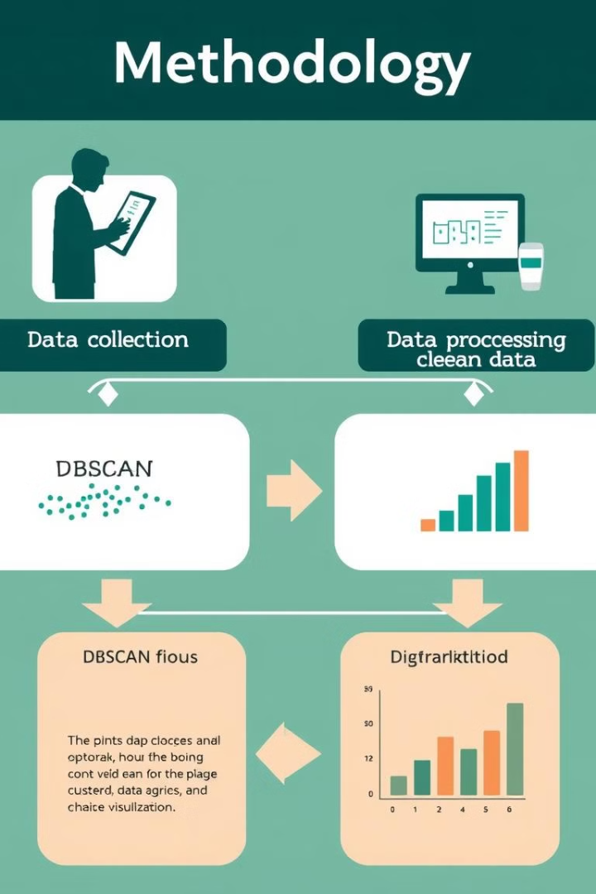




Methodology
Data Collection
Crime dataset with location, crime type, time.
Data Preprocessing
Handling missing values, scaling, encoding.
Applying DBSCAN
Identifying high-density crime regions.
Visualization
Scatter plots & heatmaps for better insights.

Slide 5
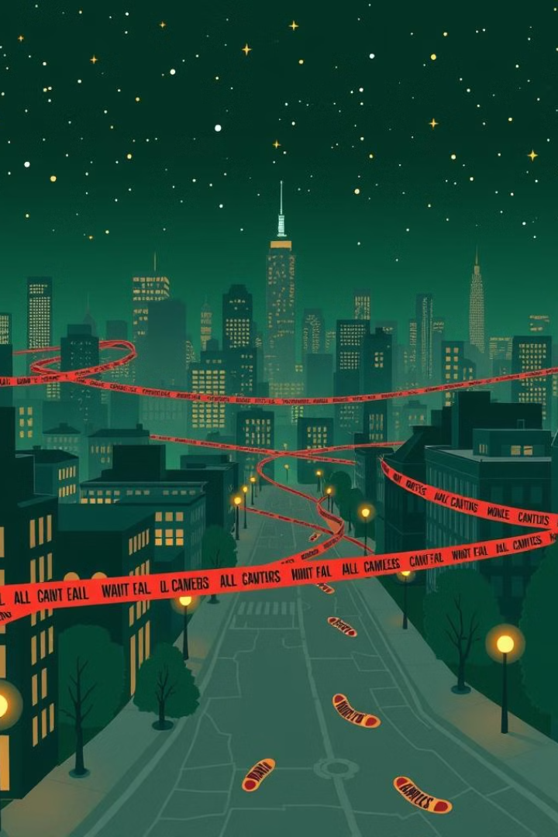
Data Collection & Preprocessing
Data Sources & Features
Preprocessing Steps
Public crime datasets, police records.
Handling missing values.
Feature normalization & encoding.
Features: Latitude, Longitude, Crime Type.
Optimizing DBSCAN parameters.

Slide 6
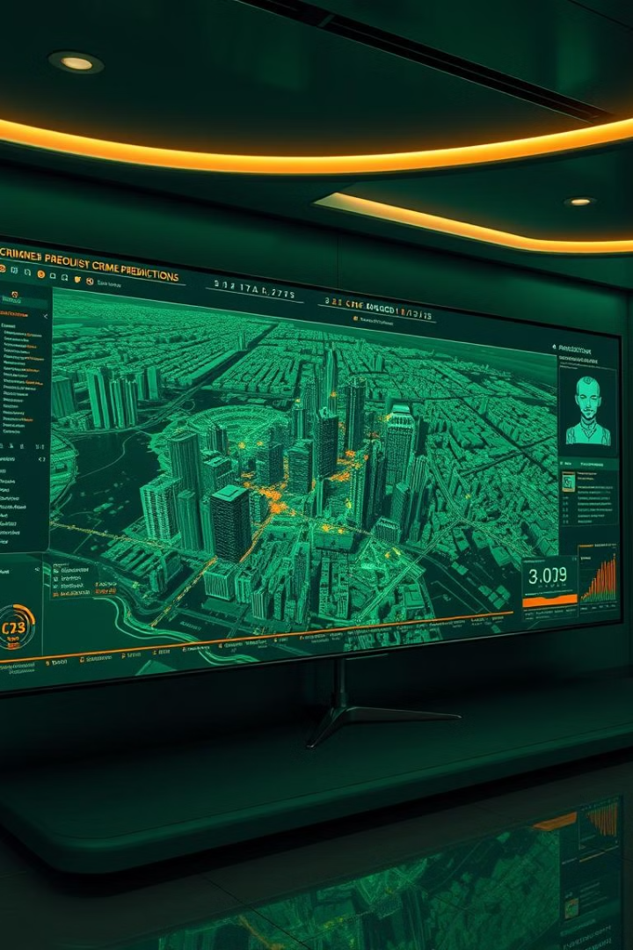
DBSCAN Algorithm & Implementation
How DBSCAN Works?
Epsilon (ε)
Density-based clustering groups nearby points, detects outliers.
Defines the neighborhood radius.
MinPts
Minimum points required to form a dense region.
Implementation (Python Libraries Used)
pandas, NumPy – Data processing.
scikit-learn – DBSCAN algorithm.
matplotlib, seaborn – Visualization.

Slide 7
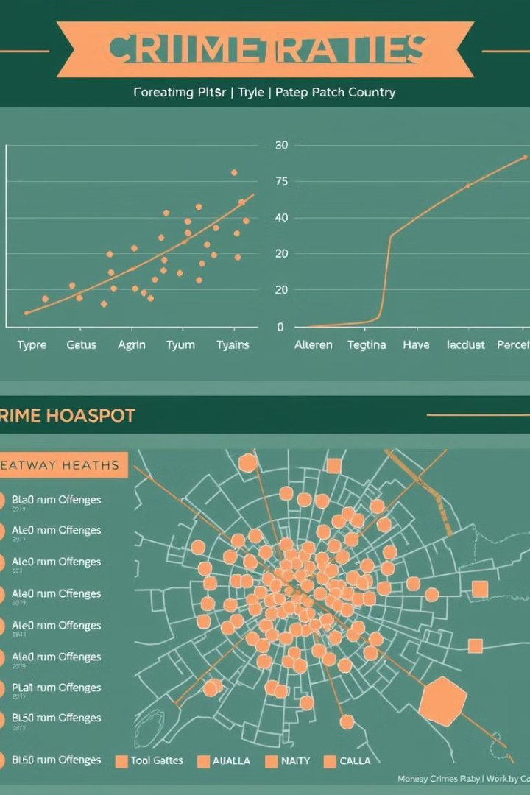



Results & Visualizations
Crime Hotspots
Detected in specific regions.
Outliers Identified
Isolated crimes needing investigation.
Visualization
Scatter plots & heatmaps enhance interpretation.

Slide 8
Challenges & Limitations
Challenges Faced
Limitations
Data Quality Issues - Missing/incomplete records.
Focuses on spatial clustering only, does not analyze temporal trends.
Parameter Sensitivity - Choosing optimal ε & MinPts.
Computational Complexity - Processing large datasets efficiently.
Lack of real-time crime data integration.

Slide 9

Future Enhancements
Predictive Analysis
Integrating Machine Learning.
Real-Time Data
Dynamic Clustering.
Interactive Dashboard
For Law Enforcement.
Hybrid Approach
Combining DBSCAN with Other Techniques.

Slide 10

Conclusion
1
Final Takeaways
2
Crime Visualization
DBSCAN effectively identifies crime hotspots & outliers.
Helps law enforcement in decision-making.
3
Further Improvements
Can enhance crime prevention strategies.

Slide 11
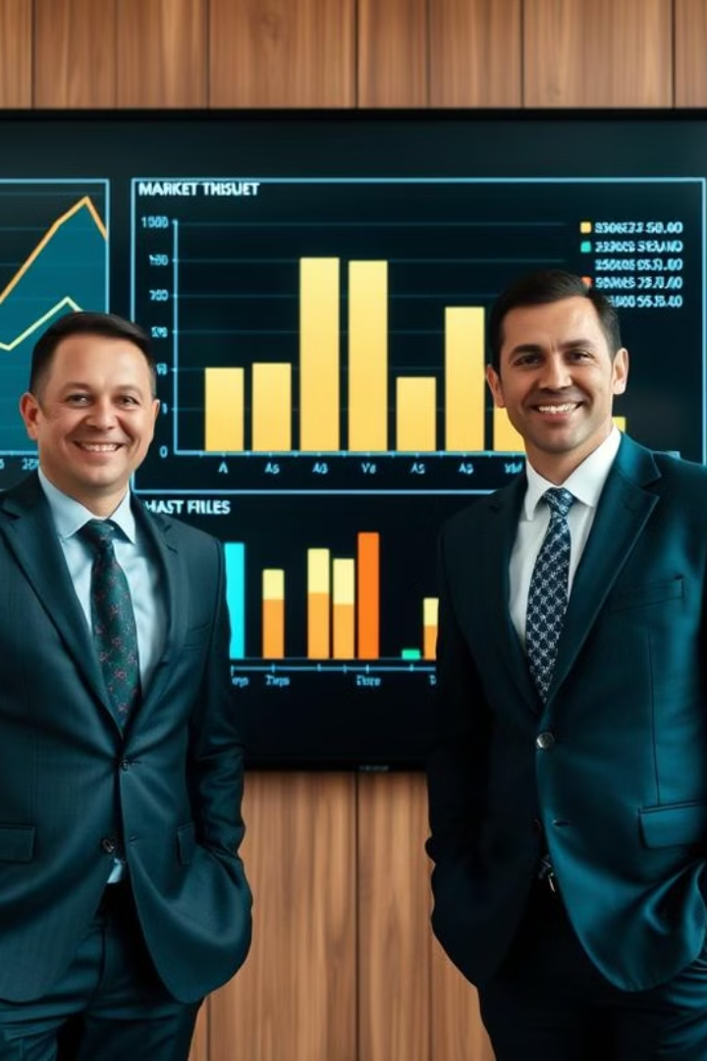
THANK
YOU !!

